Slide 1
RAILWAY TICKETING DATA BASE SYSYTEM PROJECT--1 DBMS
GROUP MEMBERS::-
J.ANJANI BABU -- 19BPS1081
M.HANUMAN SAI -- 19BPS1066
P.KARTHIK -- 19BPS101040
SRIDHAR -- 19BPS1091

Slide 2
Contents of this project
Intro to the project
ER diagram
Relational schema
Queries
Web appliation for online ticketing system
Tools used for creating railway application

Slide 3
Introduction of project
The main purpose of maintaining data base for railway reservation system is to reduce manual errors involved in booking and made it convenient for passengers to book tickets in an easy way.
Passengers can book their tickets for the train In which seats are available.For this, passengers has to provide the desired train number and the data for which ticket is to be booked ,before booking a tckt is to be booked. Before booking a tckt for a passenger,the validity of the train number and booking data is checked .
Once the number and booking date are validated, it is checked whether the seat is available.If yes the tckt is booked with confirmed data and corresponding passenger_id is generated which is unique. The passenger_id is generated which is unique . The tckt id is searched and the corresponding record is deleted searched and the correponding record is deleted with this,the first tckt is with waiting status also gets confirmed.

Slide 4
Cont...
Lists of assumptions::
1.User logged in to the irctc app with their credentials and search the trains which we want to book the tckt.
2.One user can bookunder his user id which he may or may not participate In the journey.
3.One ticket can contain many passengers .But we are limiting our database to a sigle person.
4.We are limiting trains for only 5.
5.There is also parking option at the station which facilitates to book the tickets for parking of vehicles.

Slide 5
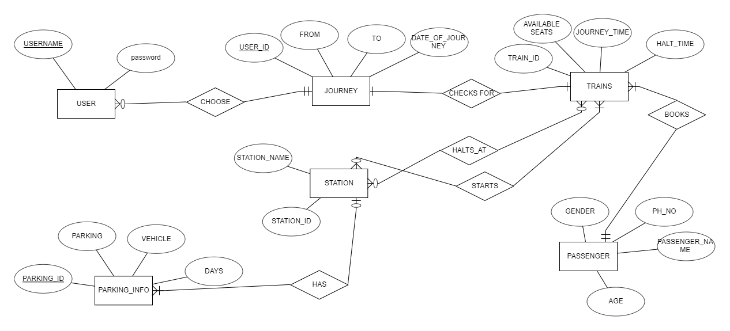
ER DIAGRAM

Slide 6
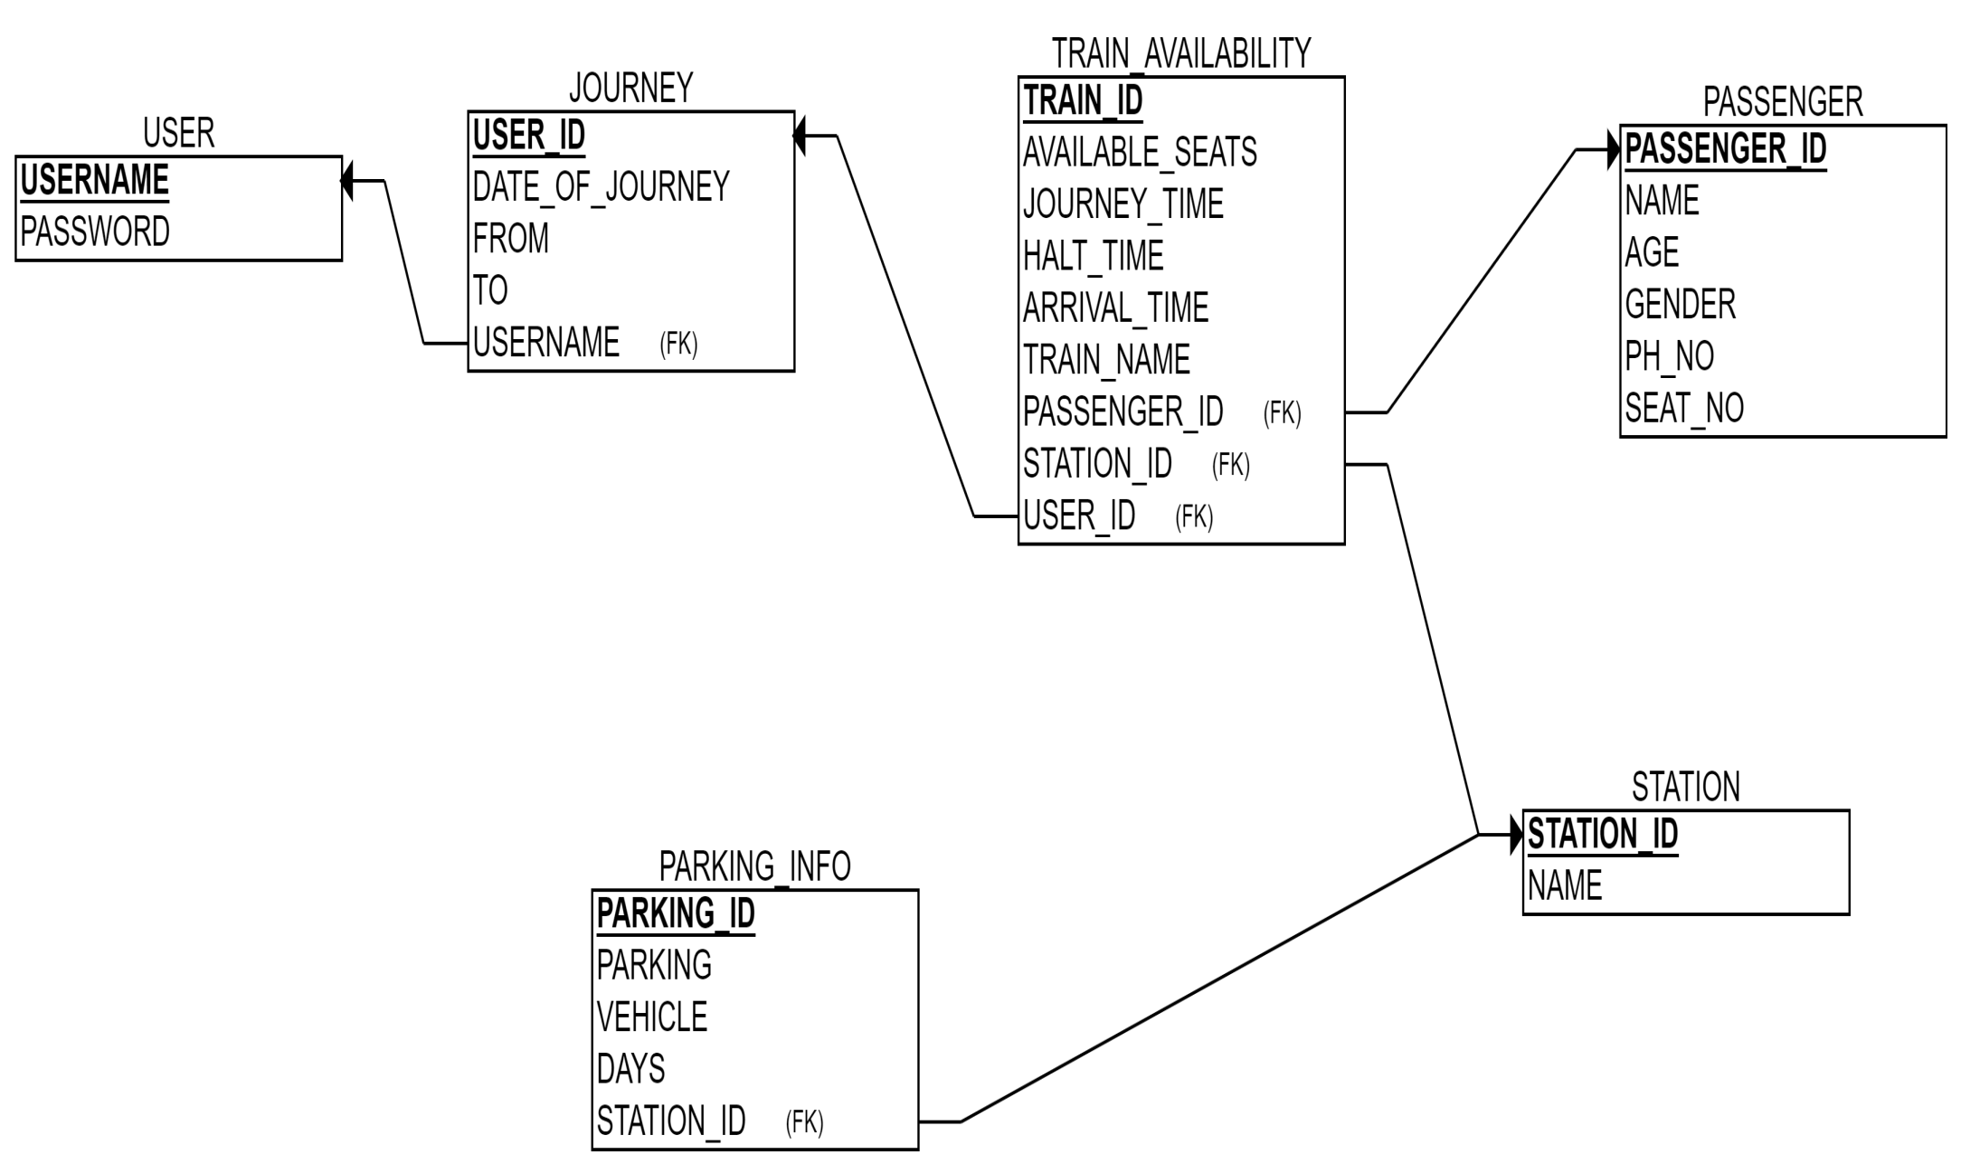
RELATIONAL SCHEMA

Slide 7
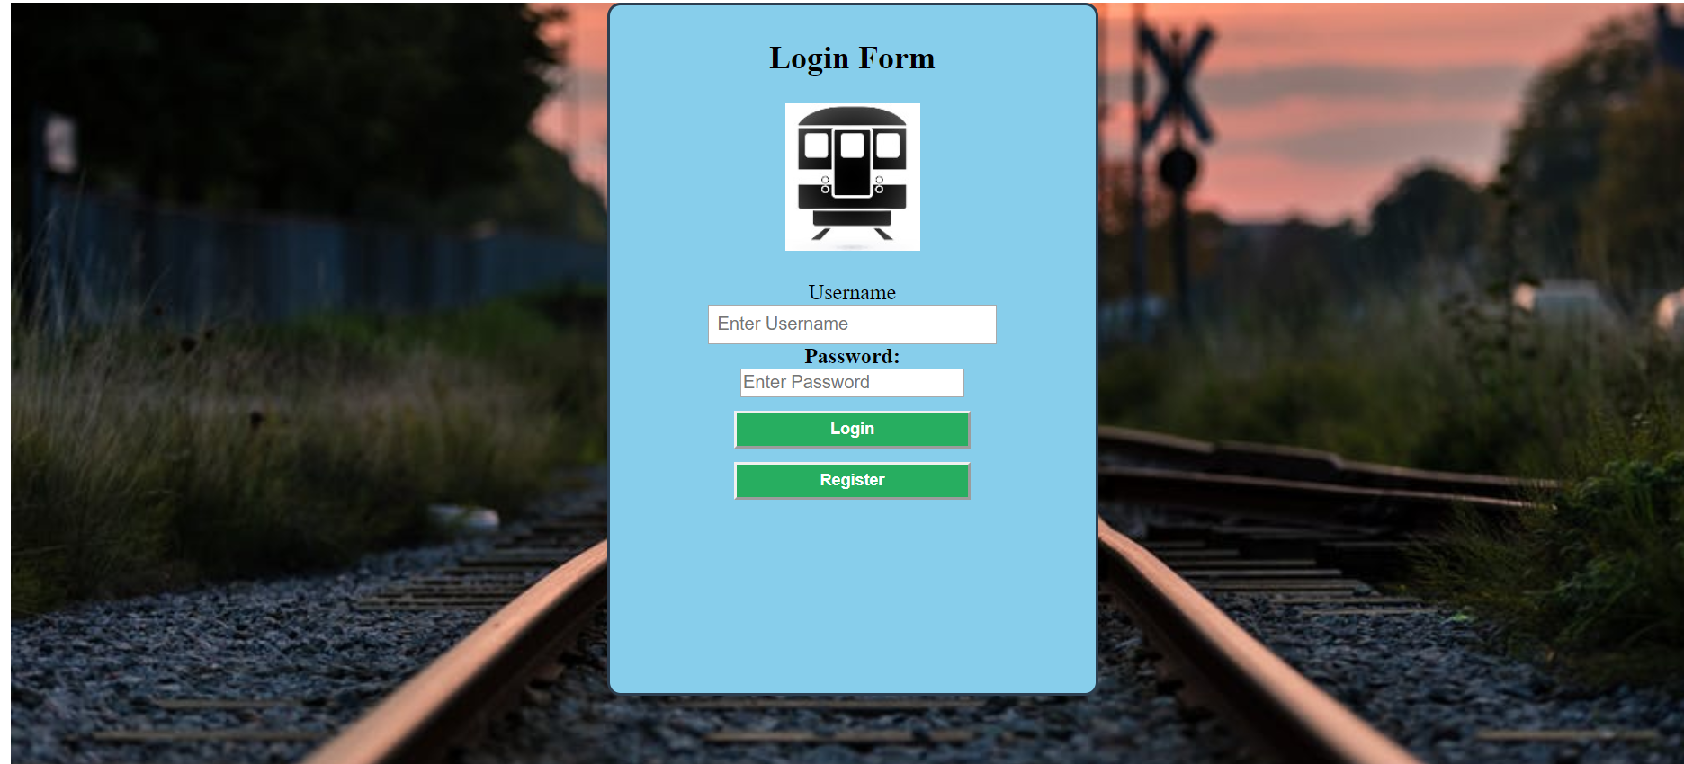
LOGIN FORM OF RAILWAY APP

Slide 8
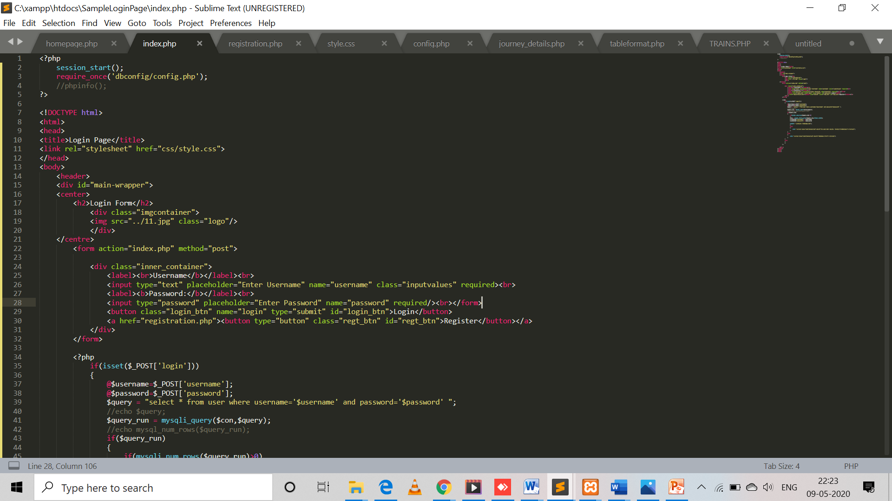
CODE FOR LOGIN FORM

Slide 9
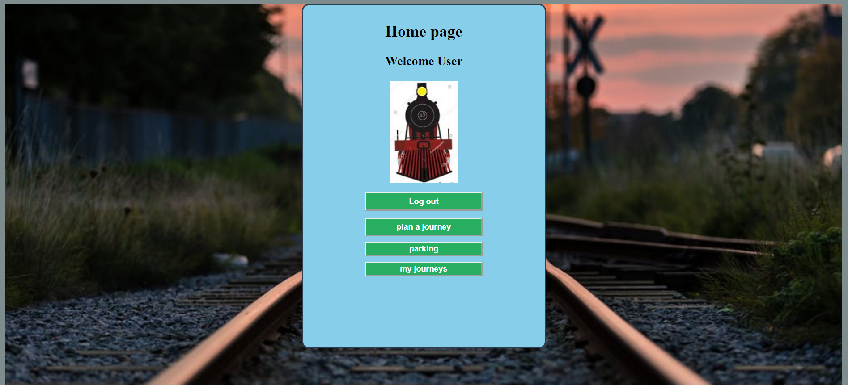
HOME PAGE

Slide 10
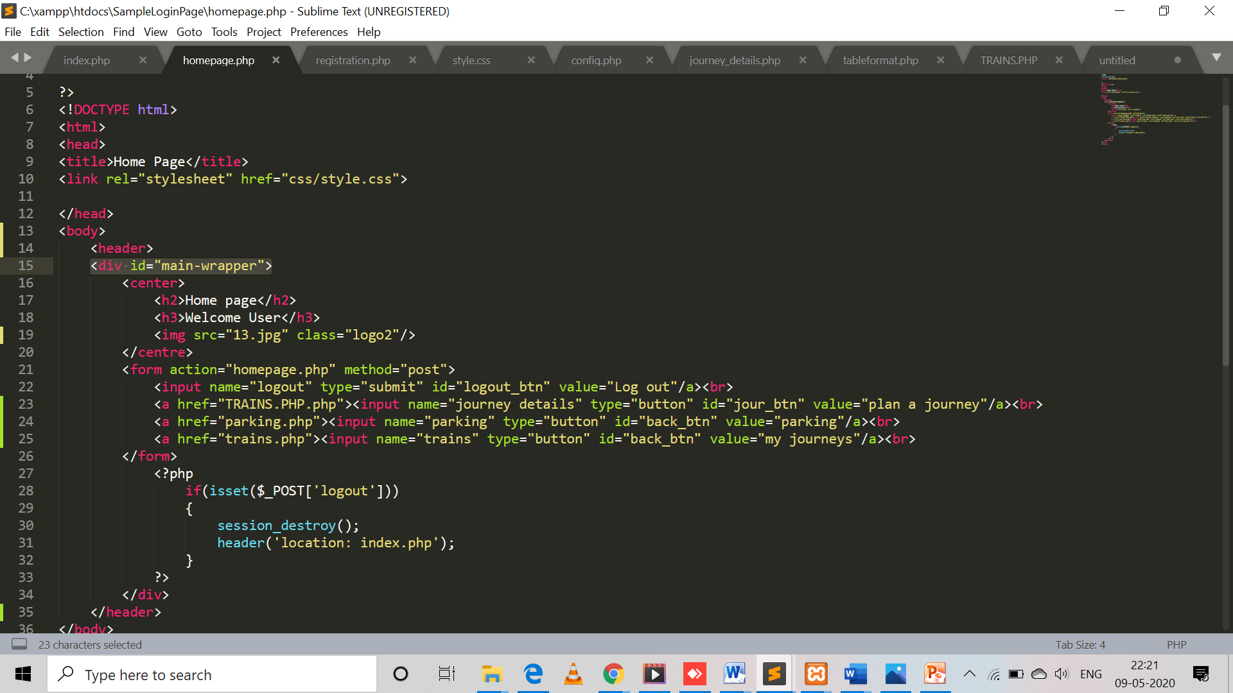
CODE FOR HOME PAGE

Slide 11
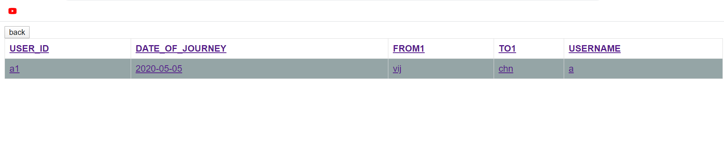
ACCEESING DATA OF TICKETS BOOKED BY USER

Slide 12
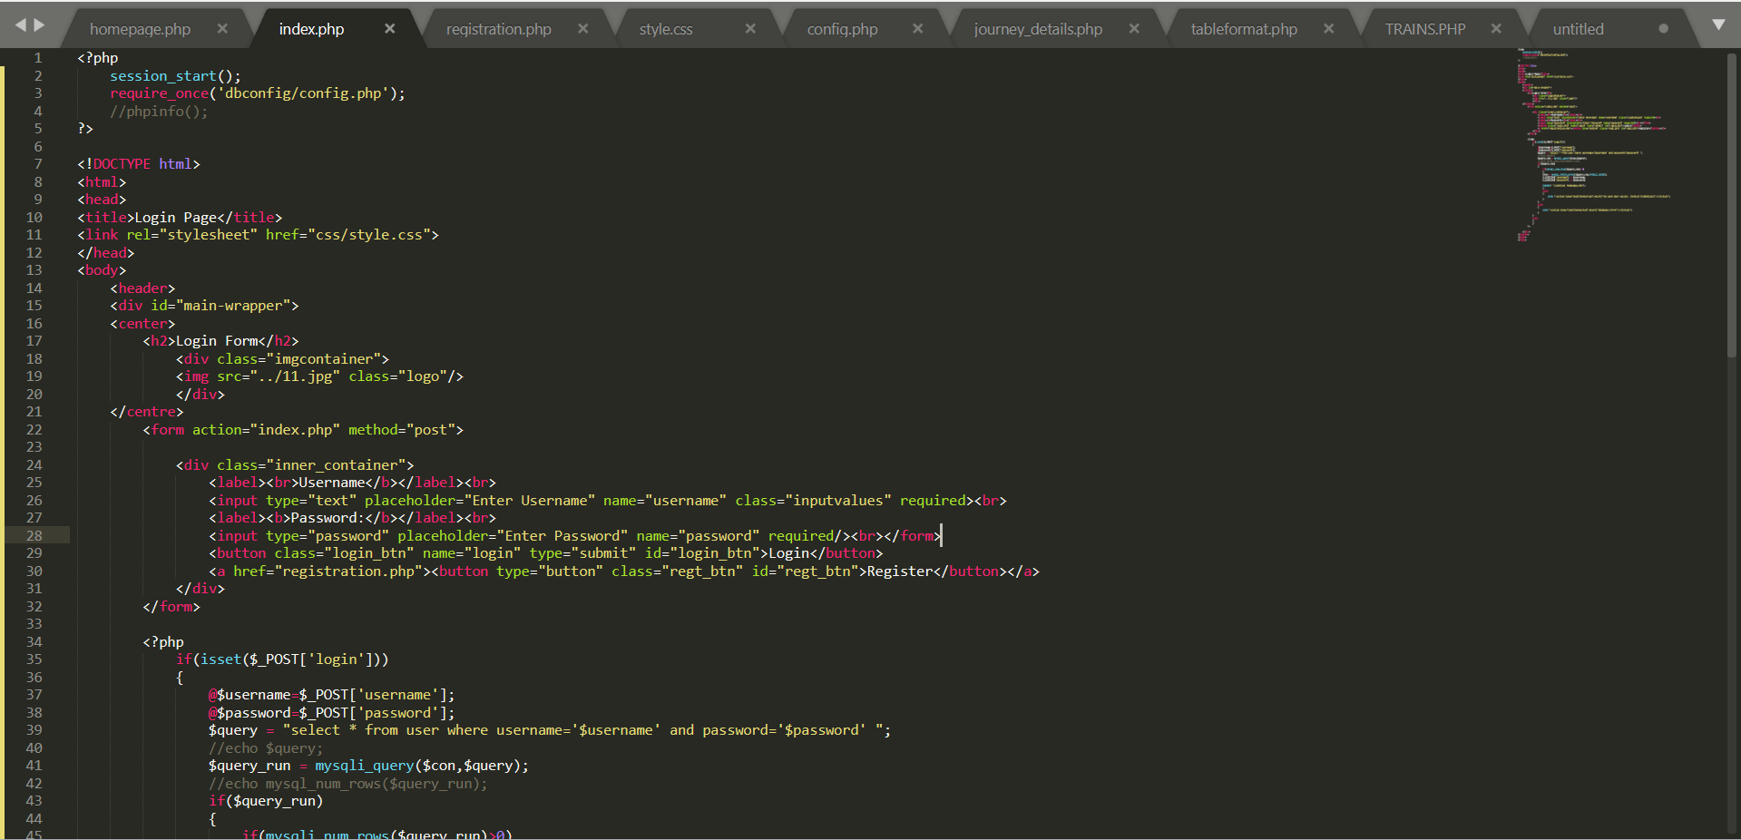
CODE TO SHOW THE HISTORY OF BOOKING STATUS

Slide 13
TOOLS USED
ERD PLUS - TO CREATE ER DIAGRAM AND RELATIONAL SCHEMA
SQL PLUS - TO CREATE DATA BASE OF THE PROJECT
XAMPP SERVER AND PHP MY ADMIN – TO CREATE RAILWAY APPLICATION

Slide 14
QUERIES……
CREATE TABLE PASSENGER(
PASSENGER_ID NUMBER(15) NOT NULL,
NAME VARCHAR2(20) NOT NULL,
AGE NUMBER(3) NOT NULL,
GENDER VARCHAR2(10) NOT NULL,
PH_NO NUMBER(10) NOT NULL,
SEAT_NO VARCHAR2(10) NOT NULL,
TRAIN_ID VARCHAR2(10) NOT NULL,
PRIMARY KEY(PASSENGER_ID)
);
CREATE TABLE STATION
(
STATION_ID VARCHAR2(15) NOT NULL,
NAME VARCHAR2(15) NOT NULL,
PRIMARY KEY (STATION_ID)
);
CREATE TABLE USERS
(
USERNAME VARCHAR2(15) NOT NULL,
PASSWORD VARCHAR2(15) NOT NULL,
PRIMARY KEY (USERNAME)
);

Slide 15
CONT….
CREATE TABLE PARKING_INFO
(
PARKING VARCHAR2(15) NOT NULL,
VEHICLE VARCHAR2(17) NOT NULL,
DAYS NUMBER(5) NOT NULL,
PARKING_ID NUMBER(10) NOT NULL,
STATION_ID VARCHAR2(15) NOT NULL,
PRIMARY KEY (PARKING_ID),
FOREIGN KEY (STATION_ID) REFERENCES STATION(STATION_ID)
);
CREATE TABLE JOURNEY
(
DATE_OF_JOURNEY DATE NOT NULL,
FROM_ST VARCHAR2(15) NOT NULL,
TO_ST VARCHAR2(20) NOT NULL,
USER_ID VARCHAR2(15) NOT NULL,
USERNAME VARCHAR2(15) NOT NULL,
PRIMARY KEY (USER_ID),
FOREIGN KEY (USERNAME) REFERENCES USERS(USERNAME)
);

Slide 16
CONT…
CREATE TABLE TRAIN_AVAILABILITY
(
AVAILABLE_SEATS NUMBER(38) NOT NULL,
JOURNEY_TIME VARCHAR2(10) NOT NULL,
HALT_TIME VARCHAR2(15) NOT NULL,
TRAIN_ID VARCHAR2(15) NOT NULL,
ARRIVAL_TIME VARCHAR2(10) NOT NULL,
TRAIN_NAME VARCHAR2(15)NOT NULL,
PASSENGER_ID NUMBER(15) NOT NULL,
STATION_ID VARCHAR2(15) NOT NULL,
USER_ID VARCHAR2(15) NOT NULL,
PRIMARY KEY (TRAIN_ID),
FOREIGN KEY (PASSENGER_ID) REFERENCES PASSENGER(PASSENGER_ID),
FOREIGN KEY (STATION_ID) REFERENCES STATION(STATION_ID),
FOREIGN KEY (USER_ID) REFERENCES JOURNEY(USER_ID)
);

Slide 17
THANK YOU

